Slide 1
The workflow:
In Python
In R
Import data
Read csv files
Join spread sheets
Average out PxC5,PxC6
Cleaning data
Set gene as index
Identify gene repeats
Drop some columns
Preprocessing
Normalization
PCA
Build visualization tool
Clustering
k-mean
t-SNE + k-mean*
MeanShift*
AgglomerativeClustering
SpectralClustering
DBSCAN*
Brich
* Not work well with this dataset
Comparing and combing
clustering results
Collective Plotting
Build ensemble
Plate map
Dendrogram*
Circular dendrogram
* Not work well

Slide 2
Data. Drop columns which end by '_cnt','_norm' or start with 'Max_','Min_’.
29 features to use:
['Green_5+foci_ratio', '1R1G_nuc_ratio', 'Nofoci_cell_ratio', 'Avg_green_periphery_std_dist', 'Avg_All_std_dist', 'Large_nuc_ratio', 'Red_1foci_ratio', 'Green_3_foci_ratio', 'Avg_RG_mean_dist', 'Red_2foci_ratio', 'Red_4foci_ratio', 'Avg_Red_mean_dist', 'Avg_All_mean_dist', 'Avg_green_periphery_mean_dist', 'Red_far_foci_ratio', 'Avg_Red_std_dist', 'Green_1foci_ratio', 'Avg_Green_std_dist', 'Green_far_foci_ratio', 'Avg_Green_mean_dist', 'Avg_RG_std_dist', 'Green_4foci_ratio', 'Green_2foci_ratio', 'Red_3_foci_ratio', 'Total_far_foci_ratio', 'Avg_red_periphery_std_dist', '1R1G_touch_nuc_ratio', 'Avg_red_periphery_mean_dist', 'Red_5+foci_ratio’]
46 features dropped:
['Cell_cnt', 'Nofoci_cell_cnt', 'Green_cell_cnt', 'Red_cell_cnt', 'Mean_green_foci_cnt', 'Mean_red_foci_cnt', 'Max_Green_mean_dist', 'Max_Green_std_dist', 'Max_Red_mean_dist', 'Max_Red_std_dist', 'Max_All_mean_dist', 'Max_All_std_dist', 'Min_RG_mean_dist', 'Min_RG_std_dist', 'Max_RG_mean_dist', 'Max_RG_std_dist', 'Min_green_periphery_mean_dist', 'Min_green_periphery_std_dist', 'Min_red_periphery_mean_dist', 'Min_red_periphery_std_dist', 'Avg_Green_mean_dist_norm', 'Avg_Green_std_dist_norm', 'Max_Green_mean_dist_norm', 'Max_Green_std_dist_norm', 'Avg_Red_mean_dist_norm', 'Avg_Red_std_dist_norm', 'Max_Red_mean_dist_norm', 'Max_Red_std_dist_norm', 'Avg_All_mean_dist_norm', 'Avg_All_std_dist_norm', 'Max_All_mean_dist_norm', 'Max_All_std_dist_norm', 'Avg_RG_mean_dist_norm', 'Avg_RG_std_dist_norm', 'Min_RG_mean_dist_norm', 'Min_RG_std_dist_norm', 'Max_RG_mean_dist_norm', 'Max_RG_std_dist_norm', 'Avg_green_periphery_mean_dist_norm', 'Avg_green_periphery_std_dist_norm', 'Min_green_periphery_mean_dist_norm', 'Min_green_periphery_std_dist_norm', 'Avg_red_periphery_mean_dist_norm', 'Avg_red_periphery_std_dist_norm', 'Min_red_periphery_mean_dist_norm', 'Min_red_periphery_std_dist_norm’]
61 genes have repeats:
{'Gdh ', 'abba ', 'TfIIFbeta ', 'RpL22 ', 'CG34180 ', 'retinin ', 'Ggamma30A ', 'CG5343 ', 'CG14414 ', 'CG4673 ', 'CG3534 ', 'Aats-arg ', 'Pros28.1A ', 'Det ', 'rap ', 'ben ', 'sphinx ', 'CG34175 ', 'CG4933 ', 'CG42288 ', 'mars ', 'CG31742 ', 'ade5 ', 'Orc1 ', 'borr ', 'Nlp ', 'Vm32E ', 'Rrp40 ', 'CG7236 ', 'CG15390 ', 'Tom40 ', 'eIF2B-delta ', 'RpII18 ', 'CG13742 ', 'CG3246 ', 'CG16986 ', 'Spc25 ', 'Irc ', 'l(1)dd4 ', 'CG11905 ', 'Bsg ', 'CG8290 ', 'CD98hc ', 'CG34350 ', 'CG42336 ', 'Arc1 ', 'CR32661 ', 'CG3817 ', 'CCKLR-17D3 ', 'CG17612 ', 'Nc73EF ', 'dgt4 ', 'sw ', 'CG13482 ', 'scra ', 'cal1 ', 'CG14463 ', 'nAcRalpha-96Ab ', 'RpL10Aa ', 'CG3162 ', 'CG17737 ‘}
PCA. PCA reduces data size from (424, 29) to (424, 10) and preserves 95% of variance.

Slide 3
Although distorting the space, t-SNE helps visualizing the relative relationship among instances

Slide 4
Comparing different clustering algorithms on toy datasets
http://scikit-learn.org/stable/auto_examples/cluster/plot_cluster_comparison.html ￼
Check file ‘Summary.pdf’ to see how these genes get clustered differently.
For more plots see
Cluster_visualization_by_PCA + k-mean.pdf
Cluster_visualization_by_PCA+birch.pdf
Cluster_visualization_by_PCA+k-mean.pdf
Cluster_visualization_by_PCA+spcl_laplacian.pdf
Cluster_visualization_by_PCA+spcl_nneighbors.pdf
Cluster_visualization_by_PCA+spcl_rbf.pdf
Cluster_visualization_by_PCA+ward.pdf
Cluster_visualization_by_PCA+ward_connection.pdf

Slide 5
Ensemble:
Check file ‘Ensemble.pdf’ and ‘Circle_dendrogram.pdf’ for dendrogram showing the final clustering result.
Try eye-balling those 61 genes with repeated instances to see where those twins gets mapped in either the t-SNE plot or dendrogram.
Ideally repeats of same gene would not separate much far away from each other if Hi-Fish and data analysis being both steady and robust.
However, I see not a few of them assigned into different clusters.

Slide 6
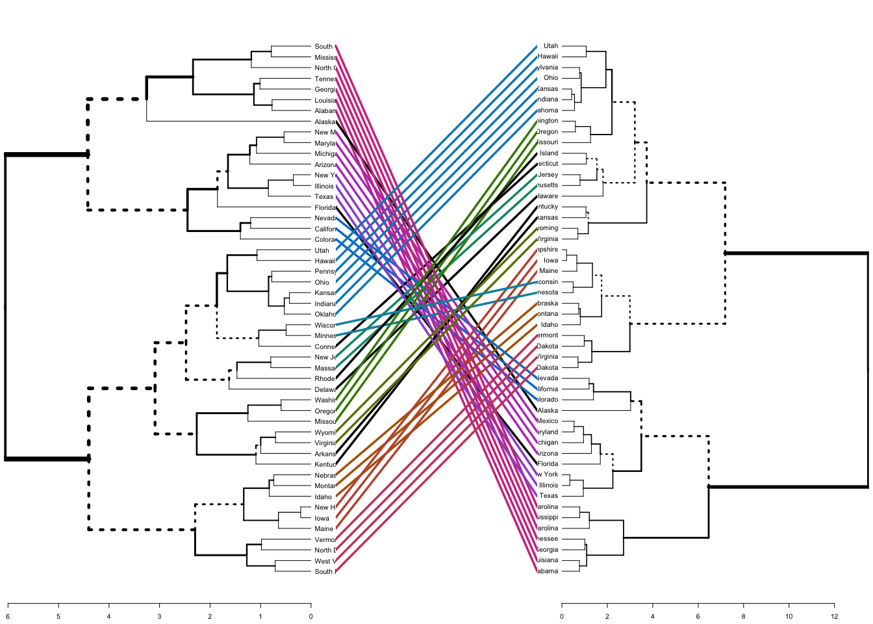
Failed trials
T-SNE and density based algorisms (MeanShift and DBSCAN) do not generate appropriate clusters here.
Trying to comparing two dendrograms, only got a mess.

